Slide 1
SECURE DATA HIDING IN IMAGES USING STEGANOGRAPHY
PROJECT
Presented By : SYED KAIF HUSSAIN
Student Name : SYED KAIF HUSSAIN
College Name & Department : CMREC & CSE(CYBERSECURITY)

Slide 2
OUTLINE
Problem Statement
Technology used
Wow factor
End users
Result
Conclusion
Git-hub Link
Future scope

Slide 3
Problem Statement
The objective of this project is to develop a secure method for hiding sensitive information within an image using steganography techniques in Python. The project ensures data confidentiality by embedding secret messages into an image and retrieving them securely using a password-protected decryption process.

Slide 4
Technology used
Programming Language: Python
Libraries: OpenCV (cv2), OS, String
Concepts Used: Image Processing, Pixel Manipulation, Steganography, Cryptography Basics

Slide 5
Wow factors
Data Security: Uses steganography to hide text inside an image, making it invisible to unauthorized users.
Password Protection: Ensures that only users with the correct passcode can retrieve the hidden message.
Simple and Efficient: Uses pixel manipulation techniques to encode and decode messages efficiently without altering image quality significantly

Slide 6
End users
Government & Military: Secure communication of sensitive information.
Cybersecurity Experts: Can be used as a learning tool for cryptography and steganography.
Individuals: Users who want to share private messages securely through images.

Slide 7
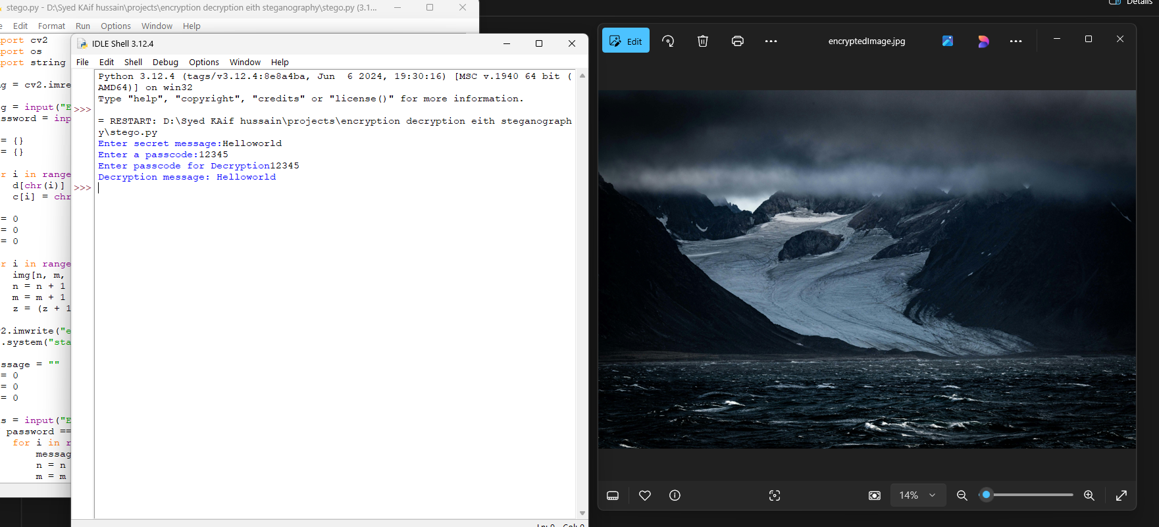
Results

Slide 8
Conclusion
This project demonstrates the use of steganography for secure communication by embedding messages in images. By utilizing pixel-level encoding, it ensures that confidential information remains hidden. The passcode-based decryption adds an additional security layer, making it an effective method for secure data transfer.

Slide 9
GitHub Link
https://github.com/hussain9347/project_Aicte_steganography.git

Slide 10
Future scope(optional)
Enhancing Security: Implementing encryption before embedding the message.
Increasing Capacity: Using advanced encoding techniques to store larger messages.
GUI Development: Creating a user-friendly interface for non-technical users.
Multi-Image Encoding: Allowing messages to be distributed across multiple images for better security.

Slide 11
THANK YOU

